Slide 1
SOLAR POWER PLANT ANALYTICS
Identifying degraded panels throughout the system
Rohit Kumar Gupta
Data Analyst | Power & Energy Analytics

Slide 2
Business Context
Solar Power plants management system relies on solar panel performance, to schedule panel & inverter maintenance.
This ensures smooth power generation by the unit without much power losses or low efficiency.
Persistent underperformance of solar panels can lead to unmet power demand &/or AC Power bottlenecking in peak generation hours.

Slide 3
Business Problem
A solar power plant operator in India is facing significant drop in efficiency of the plant.
Objective:
  Identifying the need for panel cleaning or maintenance.
  Identifying Faulty or Sub optimally performing equipment.

Slide 4
Solar Power Plant Info.
Power Plant 1
  Number of panels (Modules) = 22
  Capacity per Panel = 15000 kW
  Inverter Rating (Transformer incl.) = 1500 kVA
Power Plant 2
  Number of panels (Modules) = 22
  Capacity per Panel = 1500 kW
  Inverter Rating (Transformer incl.) = 1500 kVA

Slide 5
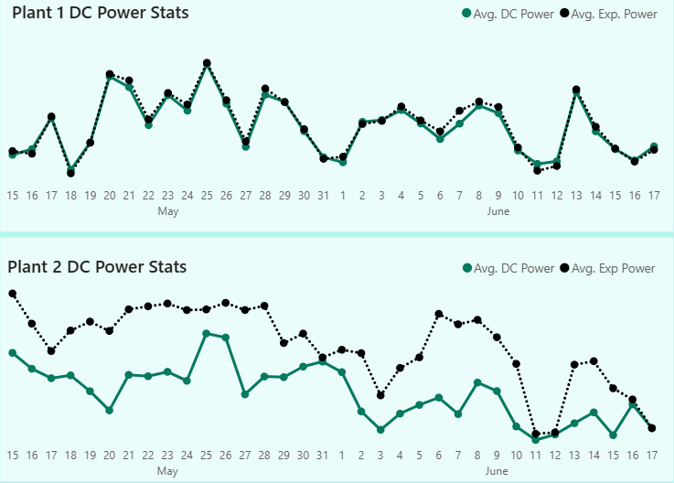
Insights
Daily generation data shows that the Plant 1 solar modules operate at higher efficiency (11.1%) higher than the Plant 2 Modules.
Solar power modules are intentionally installed higher capacity than inverters power to counter cloudy days & less irradiation. This leads to almost same average daily yield (3296 kWh for Plant 2 & 3295 kWh for Plant 2), despite plant 2 panels being less efficient.

Slide 6
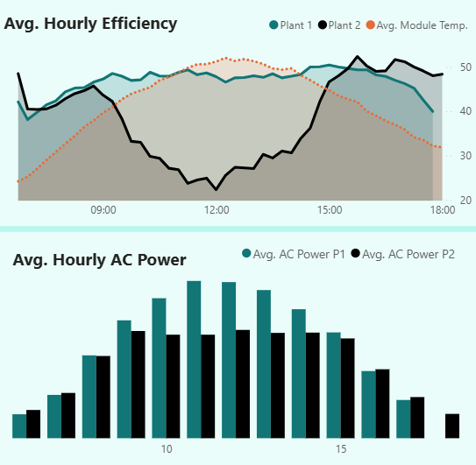
Insights
Plant 2 efficiency drops significantly from 0.97 to 0.63 during peak irradiance hours. This suggests that the plant 2 panels may have aged, or degraded, or failing.
As a result, Average hourly AC power output of plant 2 also drops or bottlenecks during peak irradiance hours. This leads to less capacity utilization.

Slide 7
Key Insights
Plant 2 shows consistent drop in efficiency as compared to plant 1 (-11.1%).
Plant 2 records consistent more critical alerts everyday as compared to plant 1.
Plant 2 panels are less efficient than plant 1. These panels require maintenance.

Slide 8
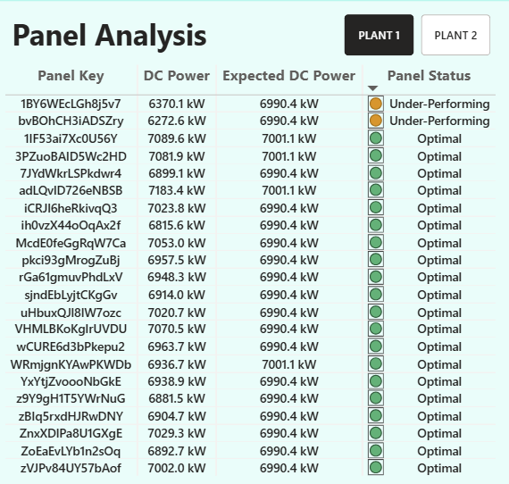
Operational Risk Areas For Plant 1
Plant 1 Panels that are underperforming:
  bvBOhCH3iADSZry.
  1BY6WEcLGh8j5v7.
These panels need cleaning/maintenance.

Slide 9
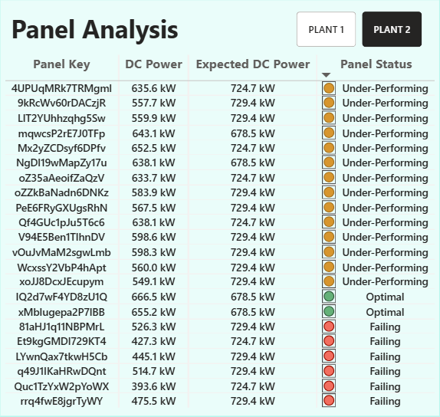
Operational Risk Areas for Plant 2
Plant 2 Panels that are Failing:
  81aHJ1q11NBPMrL
  Et9kgGMDl729KT4
  LYwnQax7tkwH5Cb
  q49J1IKaHRwDQnt
  Quc1TzYxW2pYoWX
  rrq4fwE8jgrTyWY
Plant 2 Panels that need cleaning/maintenance:
  All panels except IQ2d7wF4YD8zU1Q and xMbIugepa2P7lBB needs maintenance.
Failing panels needs replacement and underperforming panels probably needs cleaning/maintenance.

Slide 10
Recommendations and Impact
By Replacing the Failing panels and maintaining/cleaning the Underperforming panels, the plant operators can:
  Improve Solar Power Generation.
  Check bottlenecking issue.
  Increase efficiency of the overall system.

Slide 11
Tools and Skills
Python, Pandas, Numpy
Data Validation
Data Engineering
Solar Power Energy Analysis
Energy and Power Sector Analysis

